Slide 1
AVIATION SAFETY ANALYSIS
Data-Driven Aircraft Selection Strategy

Slide 2
Project Goal
Help our company safely enter the aviation industry by identifying:
• Safest aircraft types to purchase
• Lowest-risk operational strategies
• Data-backed safety protocols
DATA SOURCE
• National Transportation Safety Board (NTSB)
• 77,488 aviation accidents (1962-2023)
• Comprehensive safety analysis

Slide 3
Business Understanding
THE CHALLENGE
We're expanding into aviation but lack expertise in:
• Aircraft safety profiles
• Risk assessment
• Operational best practices
THE OPPORTUNITY
Use data to make informed decisions about:
• Which aircraft to purchase
• How to operate safely
• Where to focus training

Slide 4
Data Overview
WHAT WE ANALYZED
• 77,488 aviation accidents
• 60+ years of safety data
• Multiple aircraft categories
• Various manufacturers
KEY METRICS
• Fatality rates by category
• Accident frequency
• Safety trends over time
• Risk factors

Slide 5
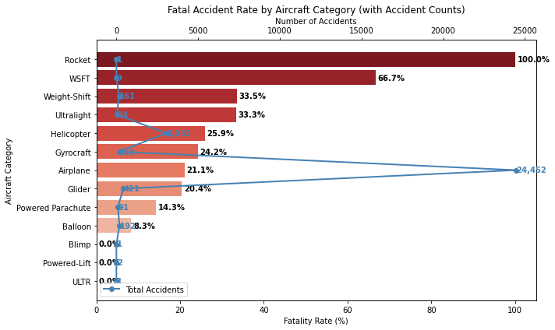
KEY FINDING: AIRCRAFT CATEGORY SAFETY
Safest Options for Our Business:
• Balloons: 8.3% fatality rate
• Powered Parachutes: 14.3%
• Gliders: 20.4%
• Airplanes: 21.1% (best balance)
Avoid High-Risk Categories:
• Rockets: 100% fatality rate
• WSFT: 66.7%
• Weight-Shift: 33.5%

Slide 6
RECOMMENDATION 1: START WITH AIRPLANES
WHY AIRPLANES?
• 21.1% fatality rate (well below average)
• 24,452 accidents analyzed (proven track record)
• Versatile for commercial & private use
• Established maintenance protocols
ACTION ITEMS:
1. Purchase initial fleet from Boeing/Airbus
2. Develop airplane-specific safety protocols
3. Train pilots on airplane operations

Slide 7
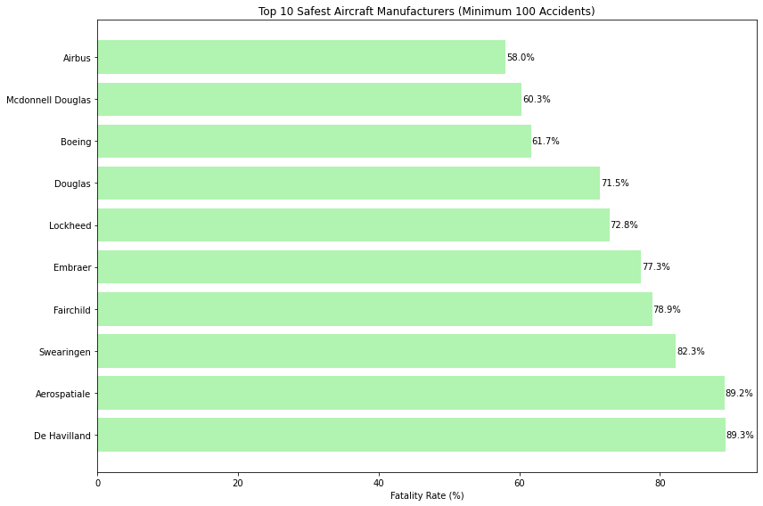
KEY FINDING: MANUFACTURER SAFETY
Top Performing Manufacturers:
• Airbus: 58.0% fatality rate
• McDonnell Douglas: 60.3%
• Boeing: 61.7% (best with high volume)
Safety with Experience:
• Boeing analyzed in 2,270 accidents
• Proven safety track record
• Reliable maintenance networks

Slide 8
RECOMMENDATION 2: PARTNER WITH BOEING
WHY BOEING?
• Best combination of safety and experience
• 61.7% fatality rate across 2,270 accidents
• Global support and maintenance network
• Proven reliability for new operators
ACTION ITEMS:
1. Establish Boeing partnership
2. Standardize on Boeing aircraft types
3. Leverage their safety programs and training

Slide 9
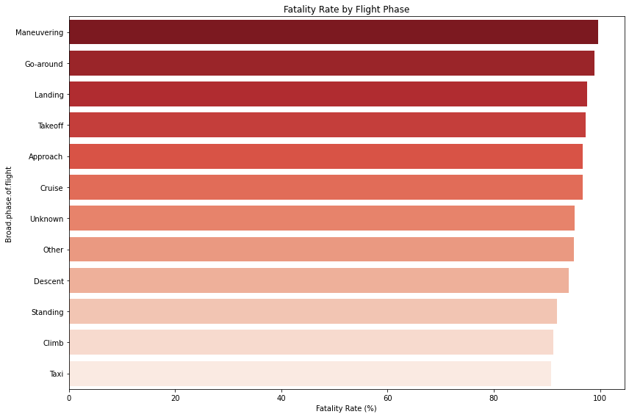
KEY FINDING: OPERATIONAL RISKS
Highest Risk Phases:
• Maneuvering phases: 99.6% fatality rate
• Go-around: 99.0% fatality rate
• Landing: 97.6% fatality rate
CRITICAL INSIGHT:
• Routine operations (takeoff/landing) are extremely dangerous
• Maneuvering has near-perfect fatality rate
• Standard procedures need complete overhaul

Slide 10
RECOMMENDATION 3: OVERHAUL OPERATIONAL SAFETY
CRITICAL FOCUS AREAS:
1. Maneuvering training (99.6% fatality rate)
2. Go-around procedures (99.0% fatality rate)
3. Landing protocols (97.6% fatality rate)
4. Takeoff safety (97.3% fatality rate)
ACTION ITEMS:
1. Develop emergency maneuver training
2. Implement strict go-around criteria
3. Enhance landing checklist procedures
4. Standardize takeoff safety protocols
5. Invest in flight simulators for high-risk phases

Slide 11
Implementation Roadmap
PHASE 1: MONTHS 1-3
✓ Purchase initial Boeing airplane fleet
✓ Develop basic safety protocols
✓ Hire and train initial pilots
PHASE 2: MONTHS 4-12
✓ Expand to additional safe categories
✓ Implement advanced training
✓ Establish safety monitoring
PHASE 3: YEAR 2+
✓ Continuous improvement
✓ Expand operations safely
✓ Become industry safety leader

Slide 12
End

